Slide 1
5 DAYS
UX CHALLENGE

Slide 2
DAY 1 : Flash Message
DAY 2 : Stopwatch
5 DAYS CHALLENGE
DAY 3 : Settings Page
DAY 4 : Dropdown Menu
DAY 5 : Slider Carousel

Slide 3
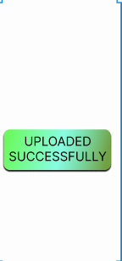


DAY 1 :
FLASH MESSAGE
There the message “uploaded successfully” is shown if the file is uploaded successfully. Otherwise it shows “error in uploading”.
https://www.figma.com/file/wxlevUeeXUVb9nKJpJ9M3d/5-Days-UX-Challenge?type=design&node-id=45-39&mode=design

Slide 4
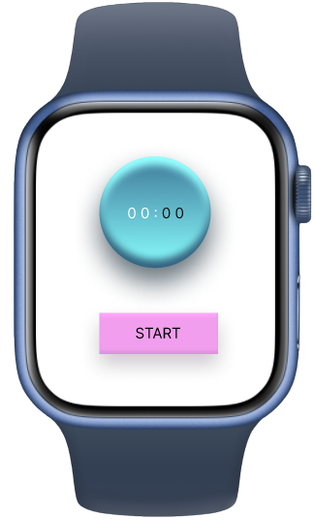
DAY 2 :
STOPWATCH
This stopwatch starts once user clicks at start button.
https://www.figma.com/file/wxlevUeeXUVb9nKJpJ9M3d/5-Days-UX-Challenge?type=design&node-id=1-663&mode=design

Slide 5
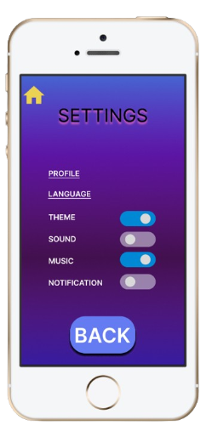
DAY 3 :
SETTINGS PAGE
Toggle switch is used for On/Off feature in settings.
https://www.figma.com/file/wxlevUeeXUVb9nKJpJ9M3d/5-Days-UX-Challenge?type=design&node-id=45-10&mode=design

Slide 6
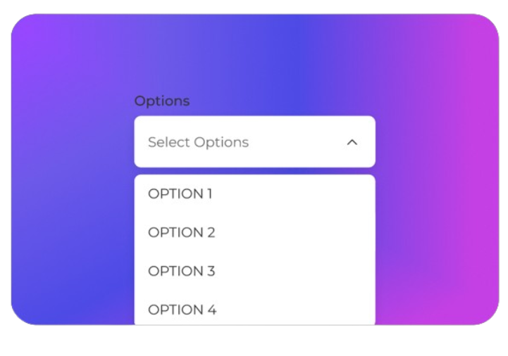
DAY 4 :
DROPDOWN MENU
This dropdown menu selects any one option from the given options from the dropdown.
https://www.figma.com/file/wxlevUeeXUVb9nKJpJ9M3d/5-Days-UX-Challenge?type=design&node-id=1-654&mode=design

Slide 7
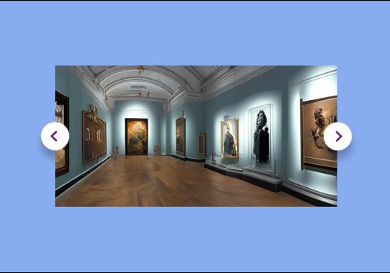
DAY 5 :
SLIDER CAROUSEL
This slider carousel consists of four pictures. We can slide through each picture with the forward and backward button.
https://www.figma.com/file/wxlevUeeXUVb9nKJpJ9M3d/5-Days-UX-Challenge?type=design&node-id=77-149&mode=design

Slide 8
THANK
YOU

